Slide 1
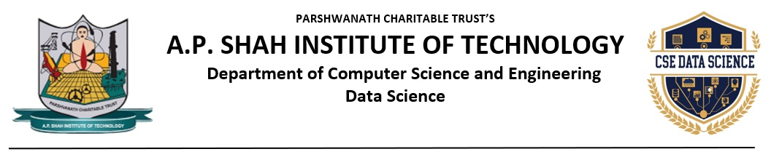
“EduQuest”
- Comprehensive Exam Prep Hub -
Yash Shinde - 23107020
Shubham Khade -23107013
Atharva Barve -23107072
Manish Sharma -23107058
Project Guide
Ms. Deepali Gat

Slide 2
Contents
Introduction
Objectives
Scope
Features / Functionality
Project Outcomes
Technology Stack
Block Diagram
GUI

Slide 3
1. Introduction
This project is a dynamic Python-based recommendation engine meticulously designed to enhance the movie-watching experience by offering personalized suggestions based on user preferences and behavior.
Our system leverages intelligent algorithms to analyze user ratings, movie genres, and viewing patterns, providing a focused and effective approach to content discovery. By utilizing machine learning techniques such as content-based filtering and collaborative filtering, the platform recommends movies that align closely with individual user tastes.

Slide 4
2. Objectives
Personalized Movie Suggestions: To provide users with tailored movie recommendations based on their preferences, ratings, or viewing history.
Demonstrate Recommendation Techniques: To implement and showcase popular recommendation algorithms such as content-based filtering and collaborative filtering.
Enhance User Engagement: To improve user experience by reducing the time spent searching for movies and increasing the chances of finding relevant content.
Practical Application of Data Science: To apply data science and machine learning concepts in a real-world scenario using Python libraries and datasets.

Slide 5
3. Scope
1. Coaching & Educational Centers - Can be integrated into coaching institutes to provide structured learning programs and performance tracking.
2. Schools & Colleges - Useful for school and college students preparing for competitive exams like JEE, NEET, MHT-CET, and GATE. It can be incorporated as a supplementary digital learning platform for exam-oriented preparation.
3. Self-Study & Independent Learners – Structure your own study plans, mock tests, and get personalized performance analytics.
4. Government & Educational Institutions - Can be used by government-backed educational programs to provide free or subsidized learning platform. Helps in bridging the gap for students who lack access to quality education.

Slide 6
4. Feature /Functionality
1. Multiple Exam Choices
Students can choose an exam (like JEE or NEET) and the specific subject (like Physics or Chemistry) that they want to study.
2. Previous Year Questions (PYQs)
Organized by subject and year for easy access. Users can access questions from past exams for better preparation.
3. Calendar & Study Planning
Simple calendar integration to track test dates. Users can set reminders for upcoming exams.
4. Automatic Scoring
The platform automatically calculates the score after each quiz and shows which answers were right and wrong. This helps students track their progress and see where they need to improve.

Slide 7
5. Outcome of Project
Users can create accounts and log in using their credentials. A "Forgot Password" feature is also included.
Upon successful login, users are presented with a dashboard displaying key information such as calendar and exam updates.
Users can navigate to different exam categories, choose specific subjects, and access previous year's questions (PYQ).
The platform displays questions for the selected subject, along with a time counter to track the user's progress.
Users can take mock tests to simulate the actual exam environment.
A report analysis section allows users to review their performance on tests and mock tests.
Users can access a section dedicated to exam-related updates.

Slide 8
6. Technology Stack
- Python Tkinter
- MYSQL

Slide 9
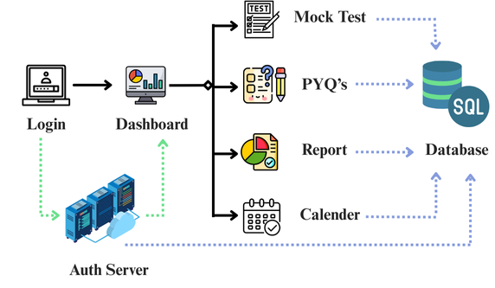
7. Block Diagram

Slide 10
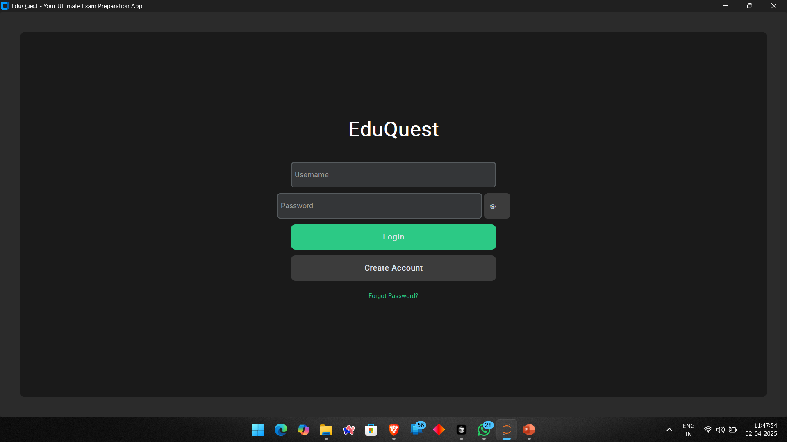
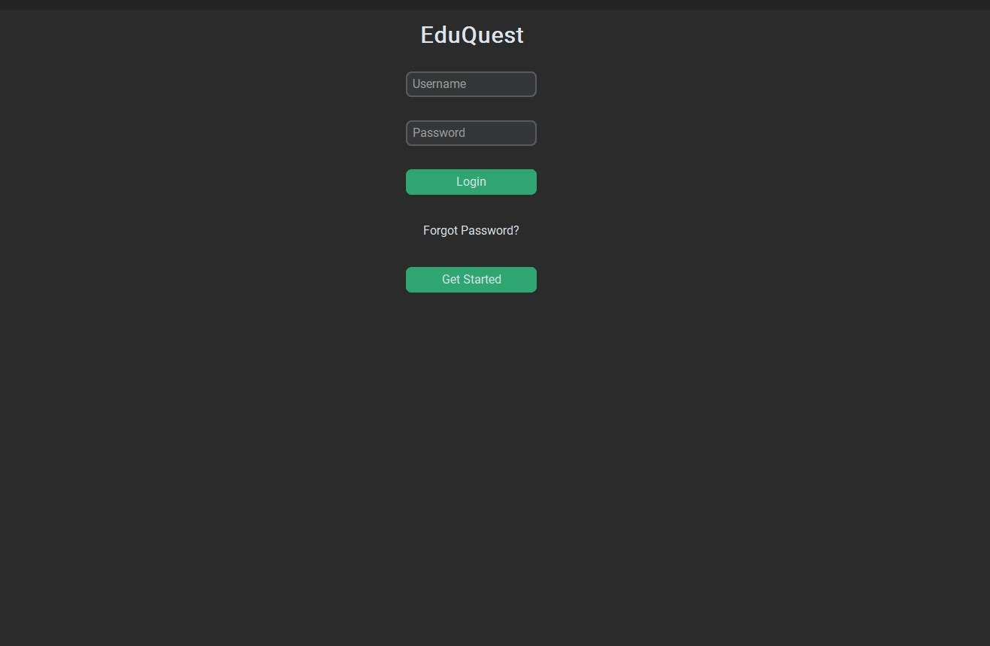
8. GUI

Slide 11
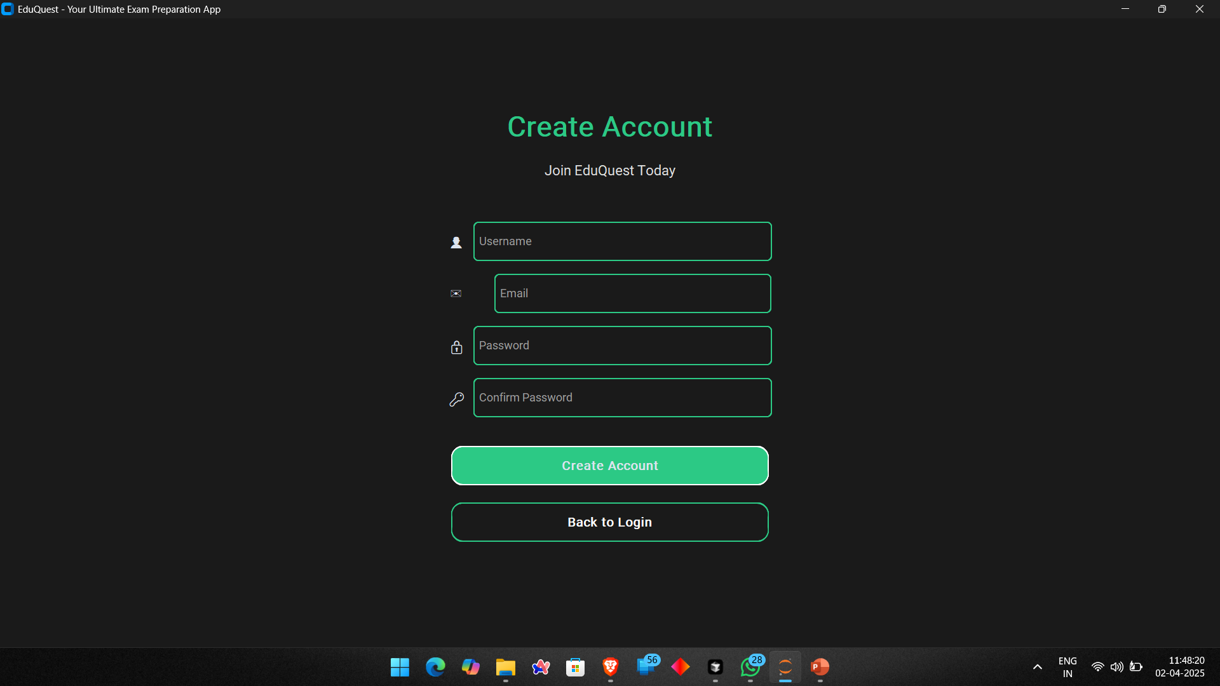

Slide 12
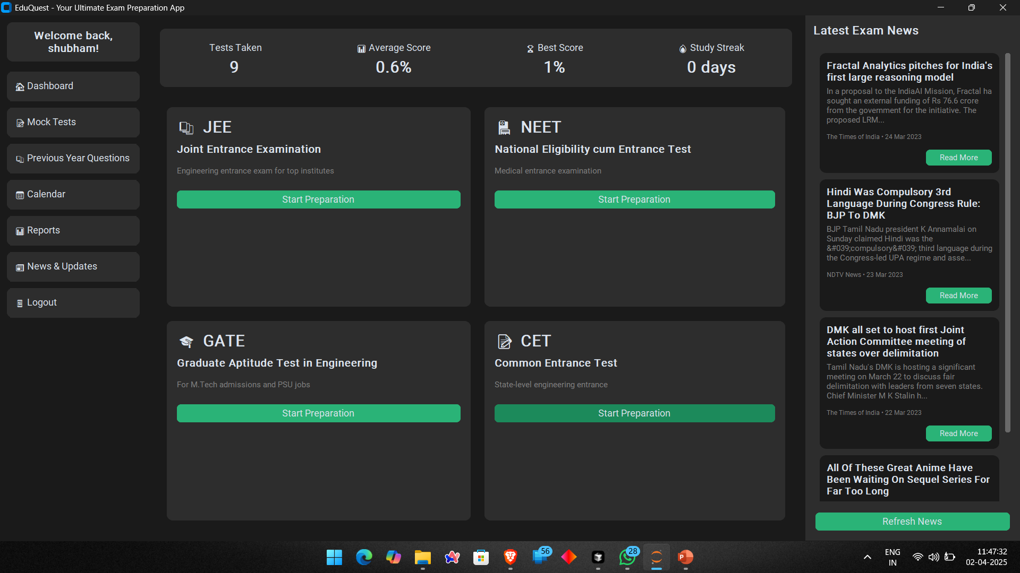

Slide 13
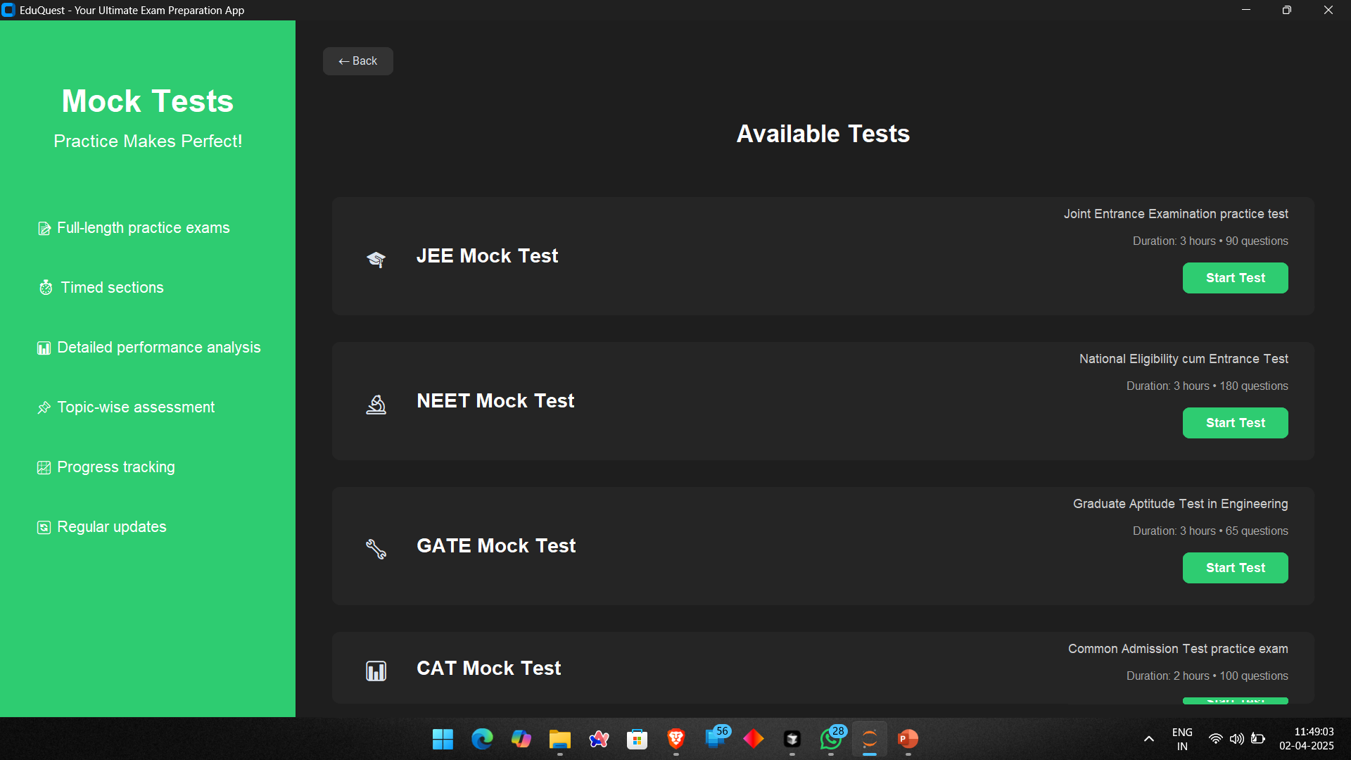

Slide 14
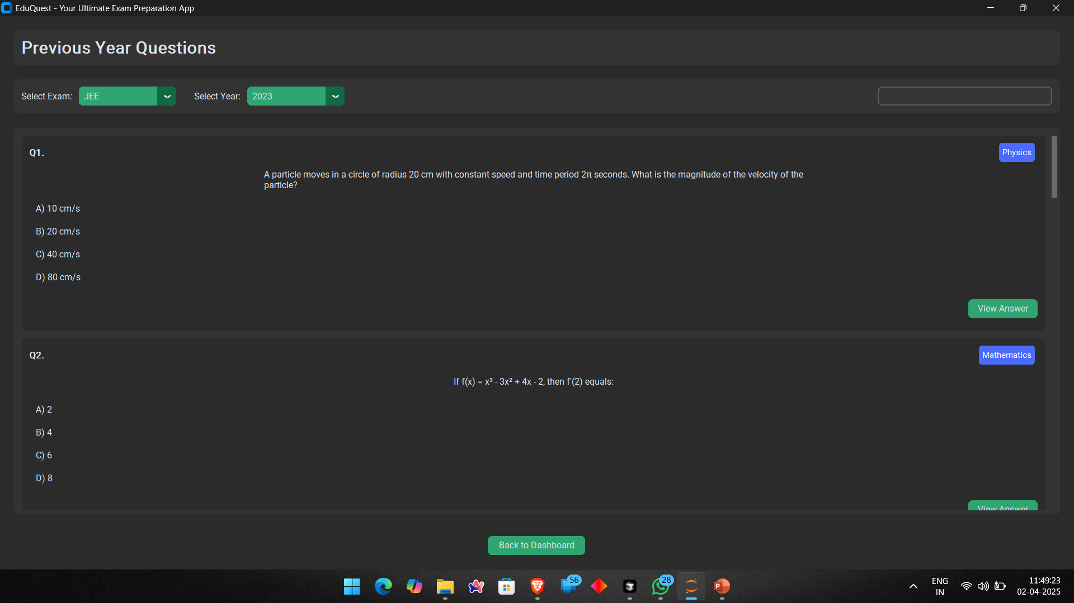

Slide 15
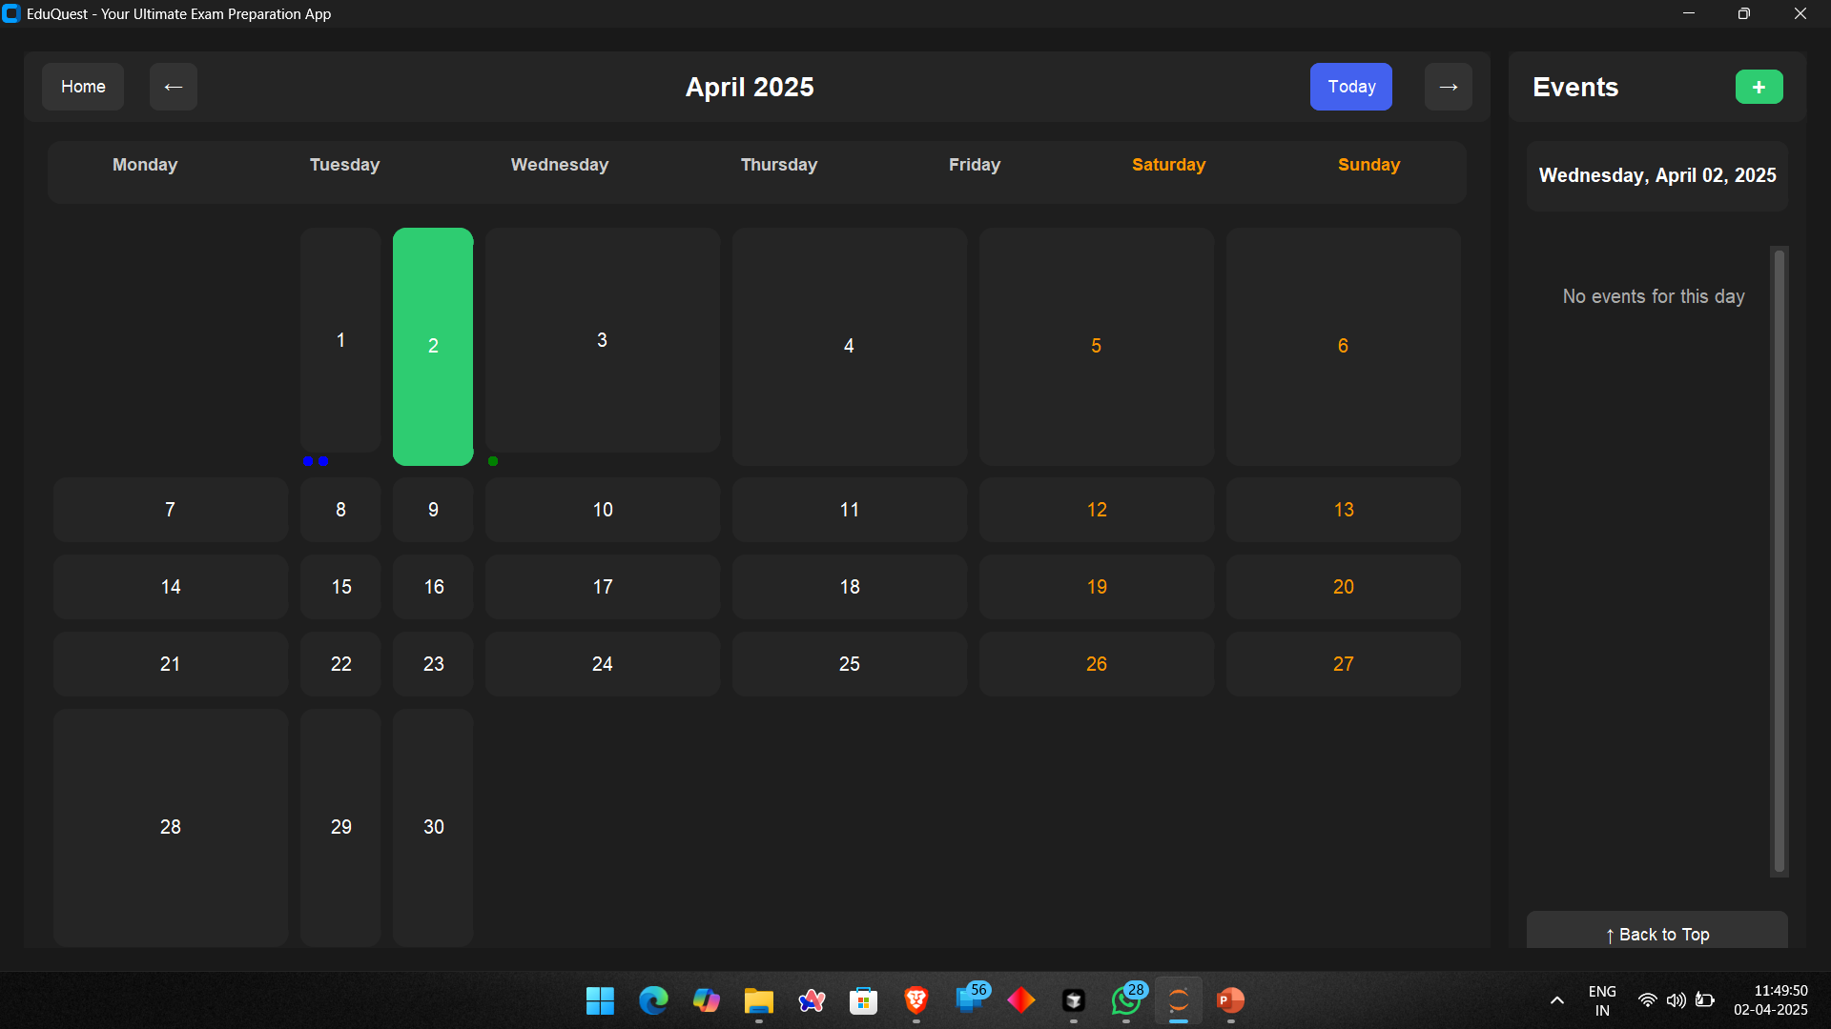

Slide 16
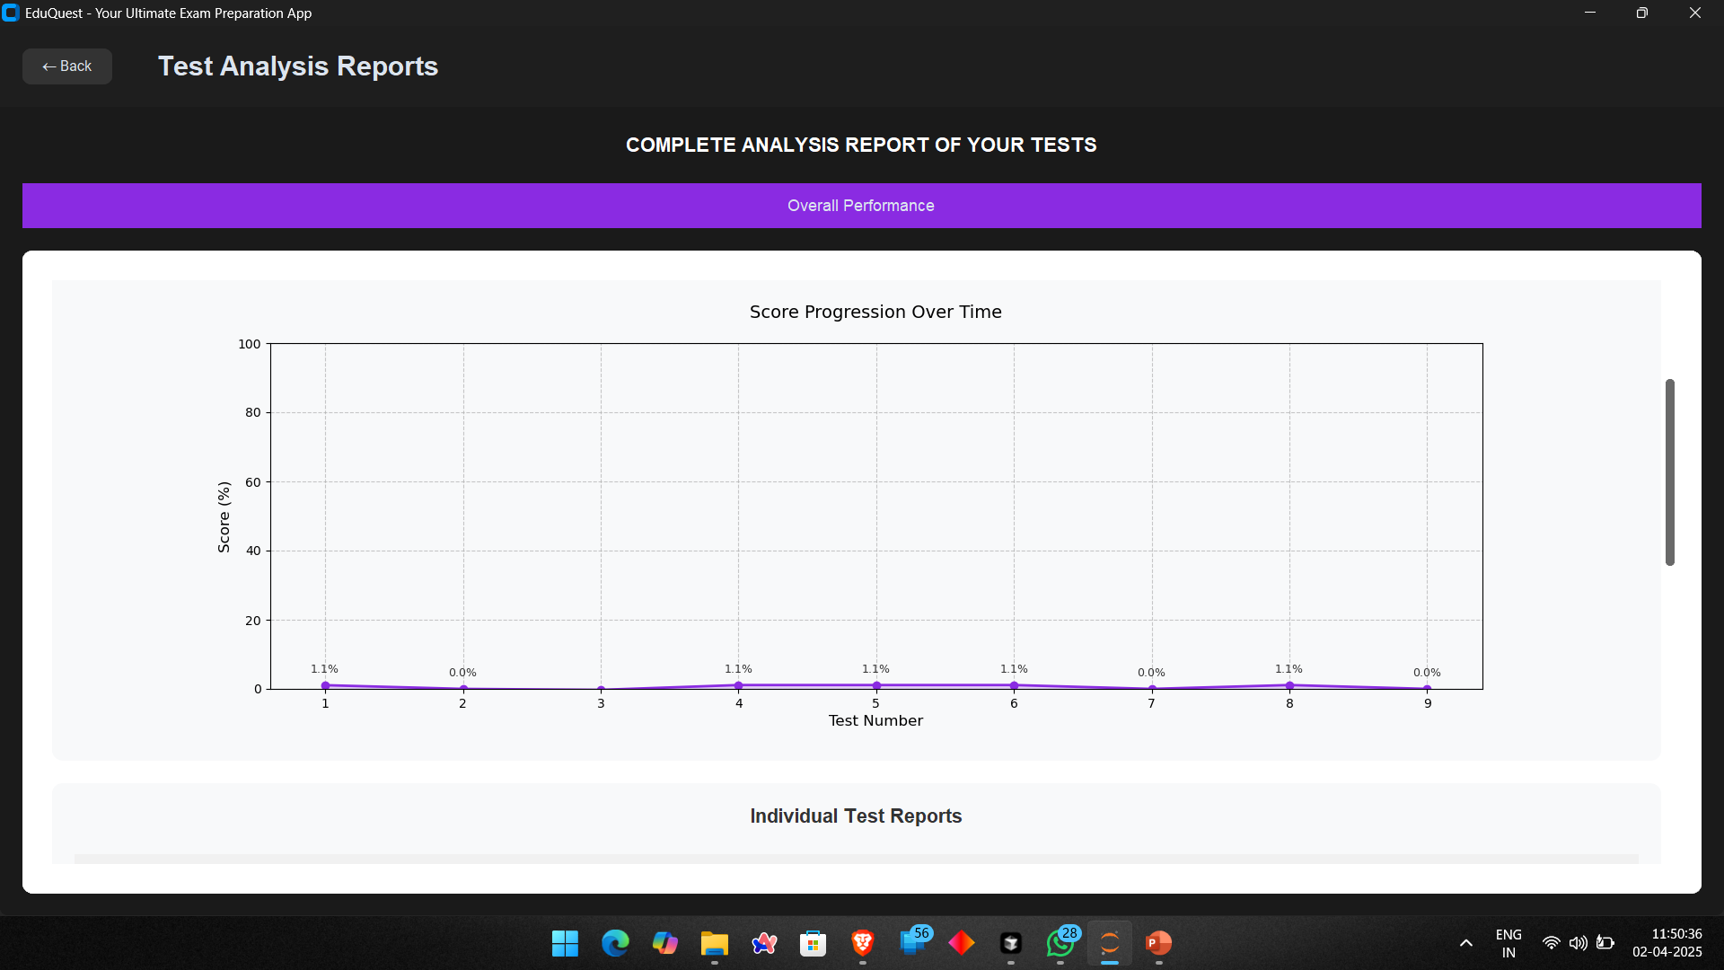

Slide 17
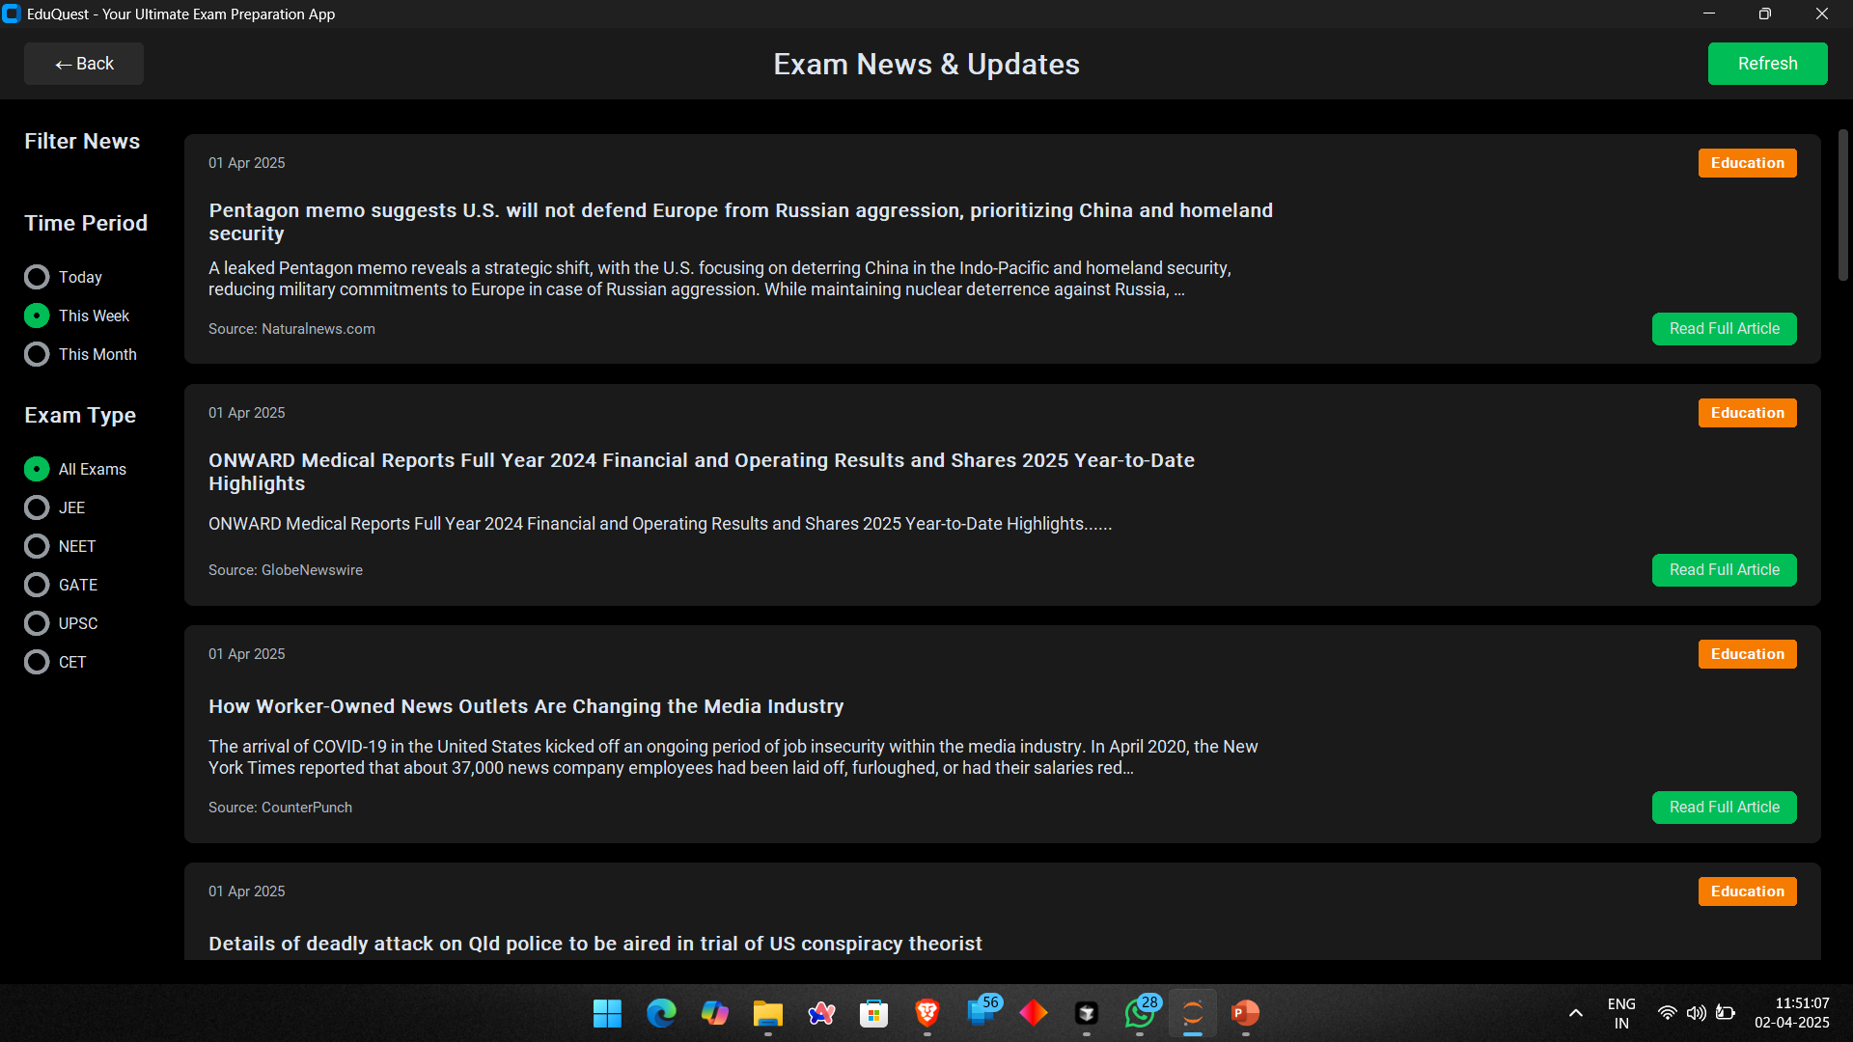

Slide 18
Thank You...!!

